Slide 1
FPU and different adders topologies

Slide 2
Names | Section | BN | Email | Roles | Time
Abdelrahman Mohamed Salem | 1 | 37 | abdosalm555@gmail.com | CBYA, CSKA with their testbench, synthesis and collecting results and their respective FPU with its testbench, synthesis and collecting results | 3 days
Ahmed Fawzy Mohamed Ibrahim | 1 | 8 | ahmed.fawzy5.5111@gmail.com | CLA, VA with their testbench, synthesis and collecting results and their respective FPU with its testbench, synthesis and collecting results | 3 days
Youssef Said Ibrahim | 2 | 40 | youssef.ibrahim01@eng-st.cu.edu.eg | CSel, CIA with their testbench, synthesis and collecting results and their respective FPU with its testbench, synthesis and collecting results | 3 days
Fady Adel | 2 | 6 | fady.abdelmassih01@eng-st.cu.edu.eg | CSA, RCA with their testbench, synthesis and collecting results and their respective FPU with its testbench, synthesis and collecting results | 3 days

Slide 3
Verilog (‘+’) version of adders
Based on the synthesis tool, it chooses from the library the most appropriate adder which fulfills the constraints specified by the end user to achieve the most optimized version of adders

Slide 4
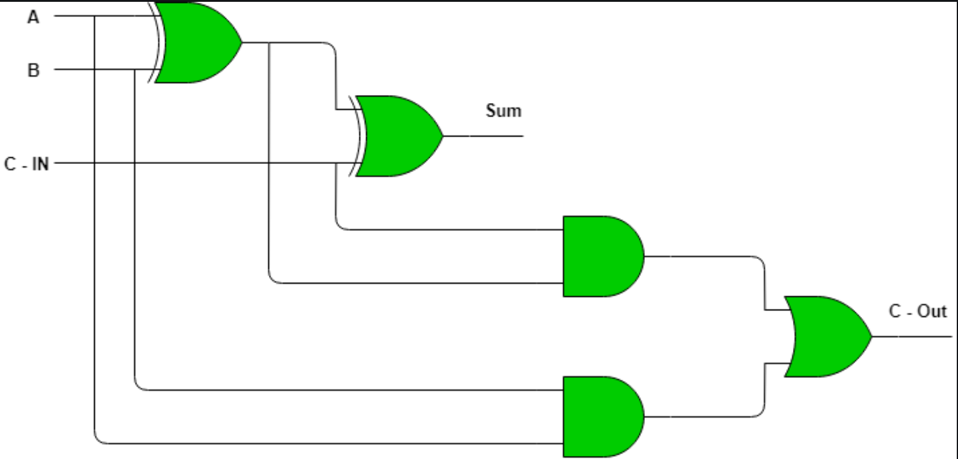
Ripple Carry Adder
A
B
Cin
FA
SUM
Cout

Slide 5
8-bit Ripple Carry Adder
A
B
Cin
A
B
Cin
A
B
Cin
A
B
Cin
A
B
Cin
A
B
Cin
A
B
Cin
A
B
Cin
Cout
FA
FA
FA
FA
FA
FA
FA
FA
SUM
Cout
SUM
Cout
SUM
Cout
SUM
Cout
SUM
Cout
SUM
Cout
SUM
Cout
SUM
Cout
Propagation delay = O(n)

Slide 6
What if we want to add 3 numbers (convention way)?
A
B
Ripple carry adder
Z
Cout
Ripple carry adder
Cin
result
Propagation delay = O(2n)

Slide 7
Carry Save Adder
A
B
Z
A
B
Z
A
B
Z
A
B
Z
A
B
Z
A
B
Z
A
B
Z
A
B
Z
FA
FA
FA
FA
FA
FA
FA
FA
0
SUM
Cout
SUM
Cout
SUM
Cout
SUM
Cout
SUM
Cout
SUM
Cout
SUM
Cout
SUM
Cout
Cout
Ripple carry adder
Result

Slide 8
8-bit Carry look ahead adder
A
B
Cin
A
B
Cin
A
B
Cin
A
B
Cin
A
B
Cin
A
B
Cin
A
B
Cin
A
B
Cin
FA
FA
FA
FA
FA
FA
FA
FA
SUM
SUM
SUM
SUM
SUM
SUM
SUM
SUM
P
G
P
G
G
P
G
P
G
G
P
G
Carry look ahead
P
P
G
P

Slide 9
8-bit Carry look ahead adder
G = A . B
G₀ = A₀ . B₀
G₁ = A₁ . B₁
G₂ = A₂ . B₂
G₃ = A₃ . B₃
G₄ = A₄ . B₄
G₅ = A₅ . B₅
G₆ = A₆ . B₆
G₇ = A₇ . B₇
P = A ⊕︀ B
P₀ = A₀ ⊕︀ B₀
P₁ = A₁ ⊕︀ B₁
P₂ = A₂ ⊕︀ B₂
P₃ = A₃ ⊕︀ B₃
P₄ = A₄ ⊕︀ B₄
P₅ = A₅ ⊕︀ B₅
P₆ = A₆ ⊕︀ B₆
P₇ = A₇ ⊕︀ B₇
S = A ⊕︀ B ⊕︀ Cin
S₀ = A₀ ⊕︀ B₀ ⊕︀ C₋₁
S₁ = A₀ ⊕︀ B₀ ⊕︀ C₀
S₂ = A₀ ⊕︀ B₀ ⊕︀ C₁
S₃ = A₀ ⊕︀ B₀ ⊕︀ C₂
S₄ = A₀ ⊕︀ B₀ ⊕︀ C₃
S₅ = A₀ ⊕︀ B₀ ⊕︀ C₄
S₆ = A₀ ⊕︀ B₀ ⊕︀ C₅
S₇ = A₀ ⊕︀ B₀ ⊕︀ C₆
C_{i} = G_{i} + (P_{i} .︀ C_{i-1})
C₀ = G₀ + (P₀ .︀ C₋₁)
C₁ = G₁ + (P₁ .︀ C₀)
C₂ = G₂ + (P₂ .︀ C₁)
C₃ = G₃ + (P₃ .︀ C₂)
C₄ = G₄ + (P₄ .︀ C₃)
C₅ = G₅ + (P₅ .︀ C₄)
C₆ = G₆ + (P₆ .︀ C₅)
C₇ = G₇ + (P₇ .︀ C₆)

Slide 10
Carry skip adder
B
A
A
B
4-bit Ripple carry adder
Cin
Cin
4-bit Ripple carry adder
Cout
Cout
Sum
Sum
Skip logic
Skip logic
Cout

Slide 11
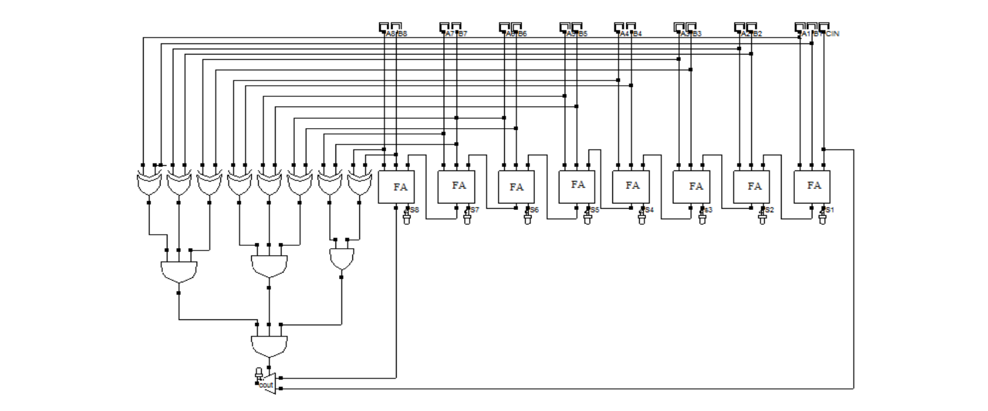
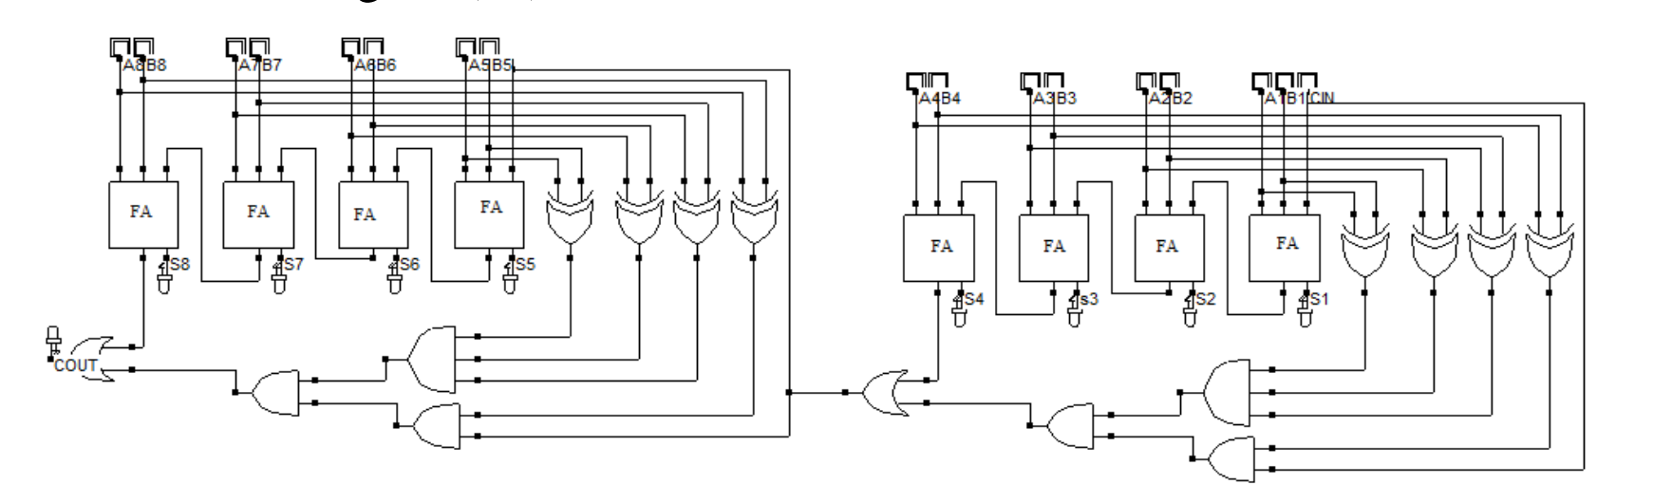
Carry Bypass adder
It’s just the same as the carry bypass adder, but the only difference is that instead of an OR gate, there is a MUX. For some reason IDK why? The synthesis tool showed that the carry bypass adder shows more speed than the carry skip adder.
Carry Skip adder
Carry Bypass adder

Slide 12
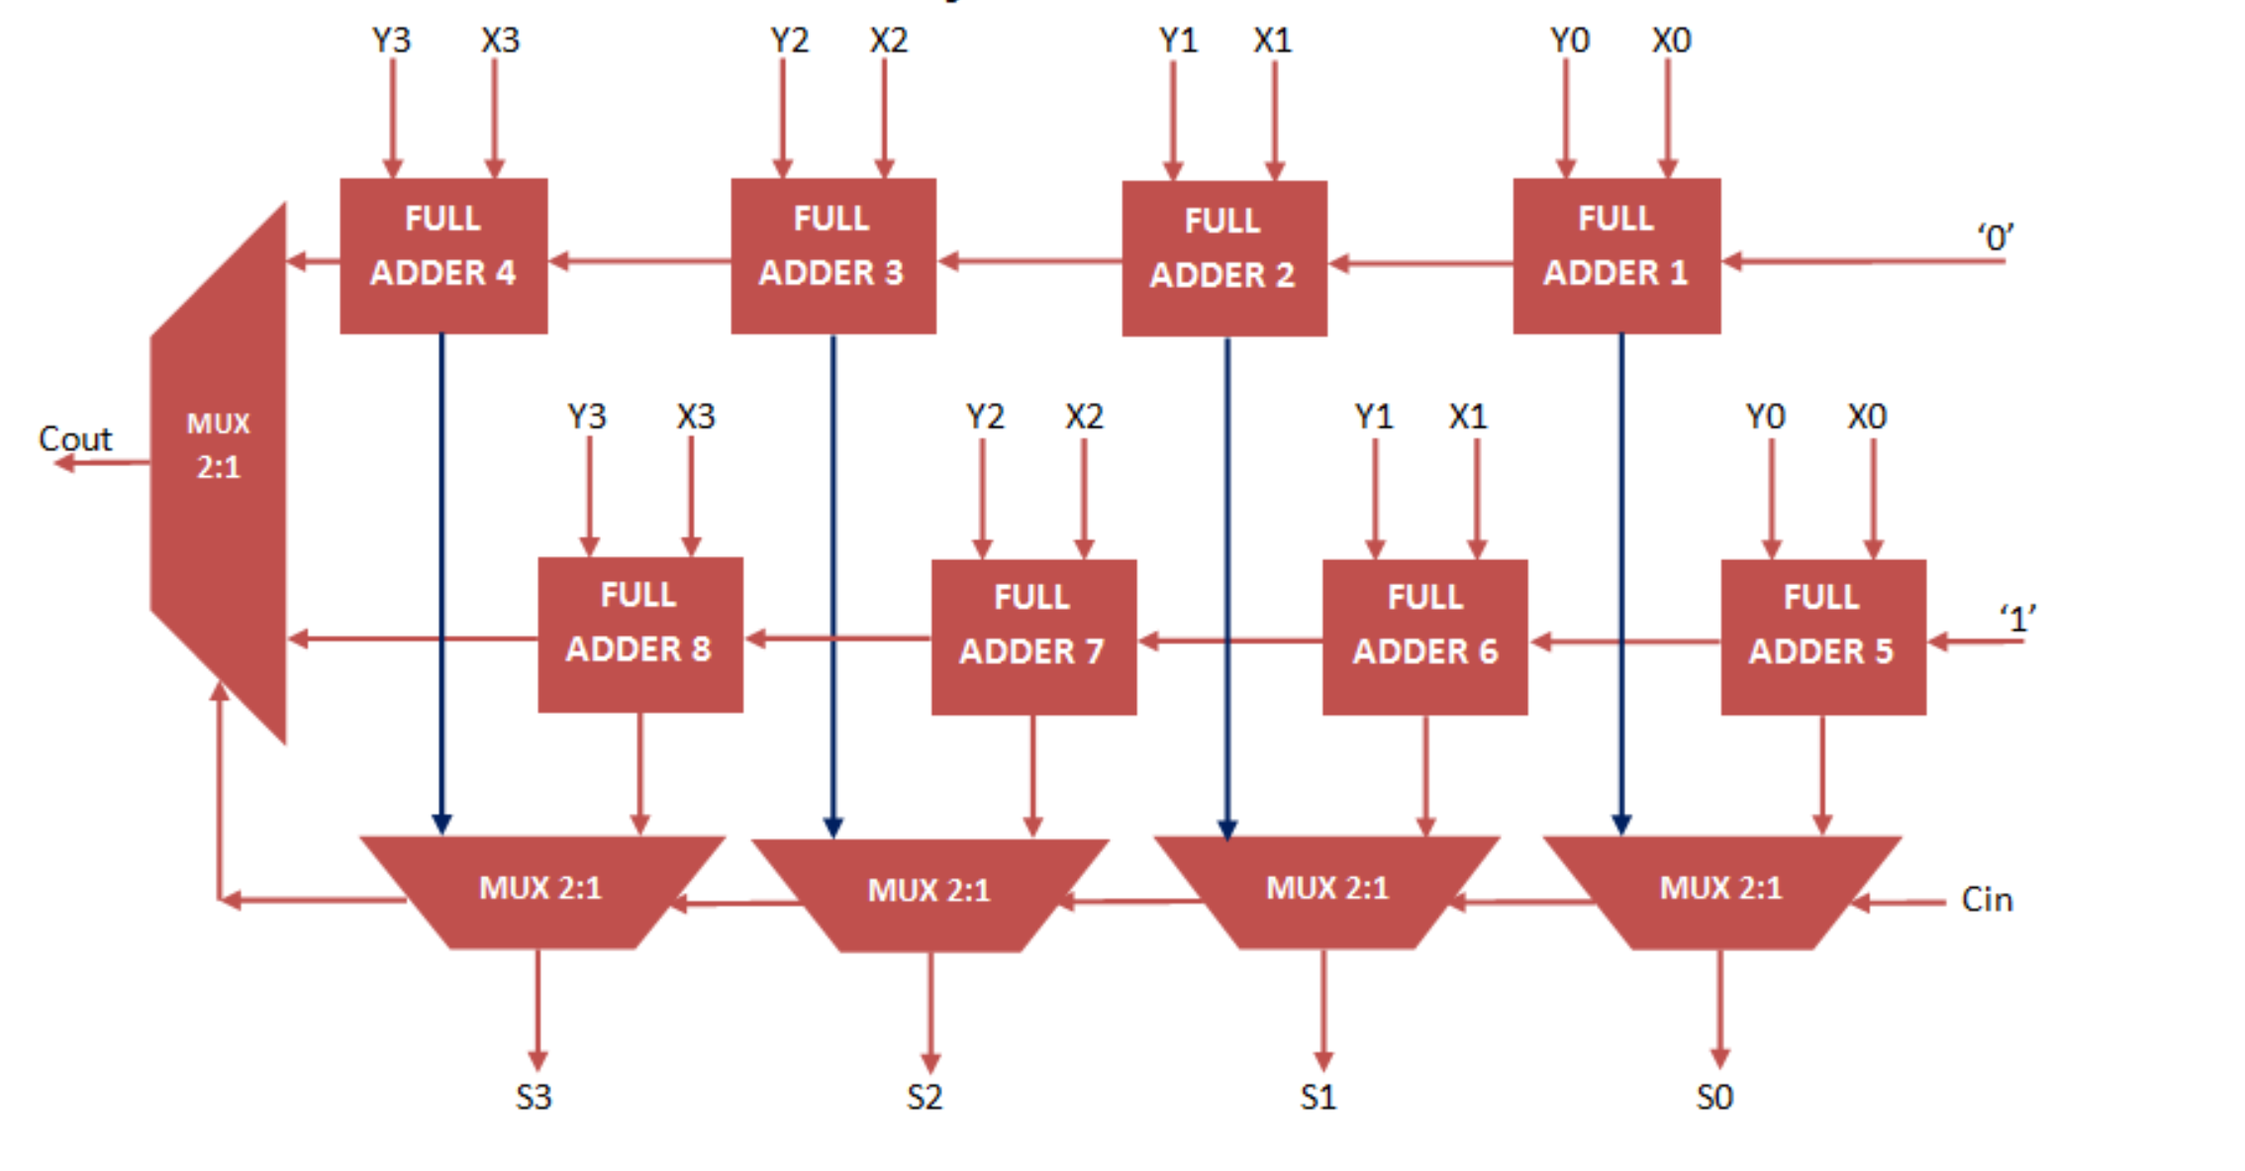
Carry Select adder

Slide 13
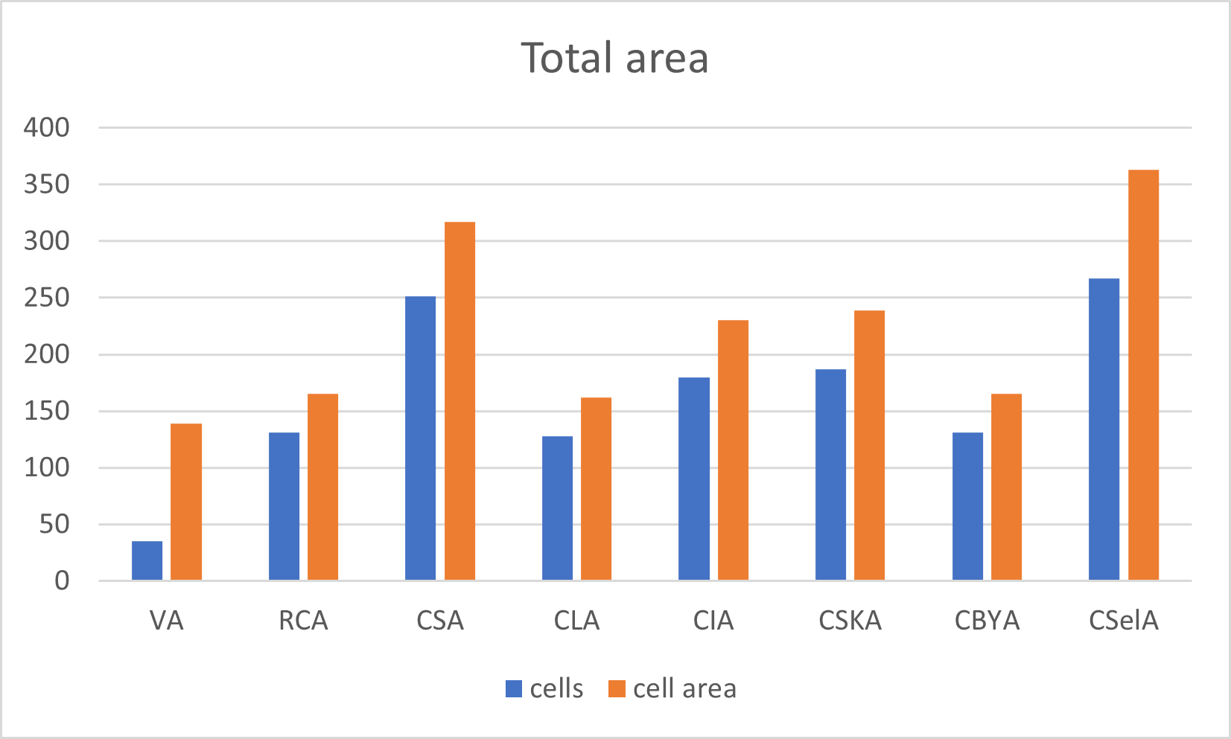
Total area graphs (after synthesis)

Slide 14
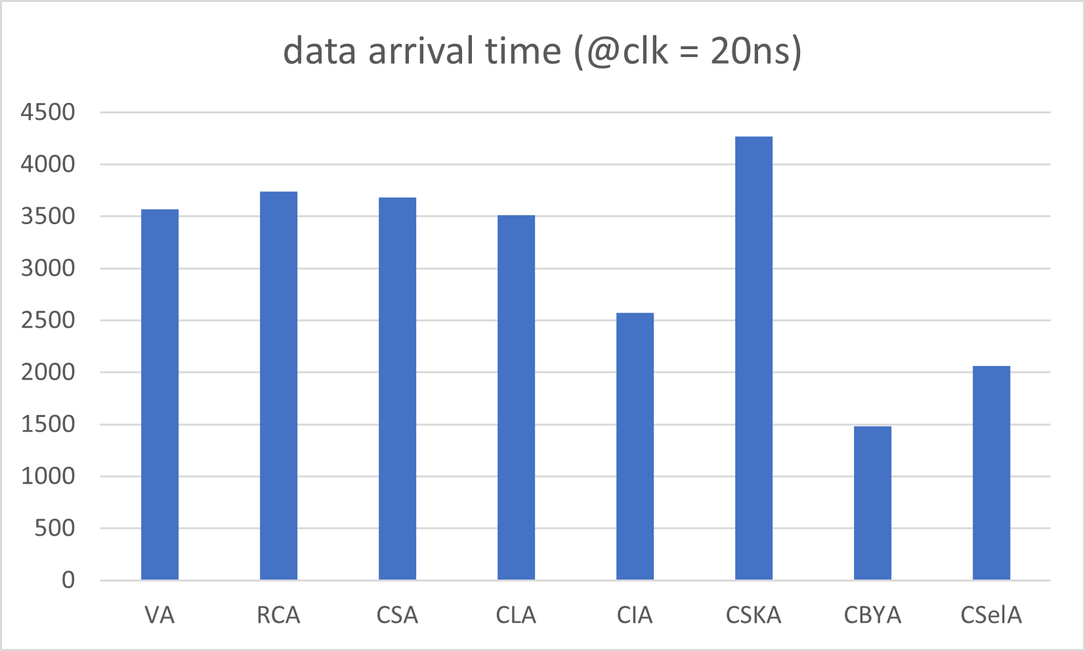
Data arrival time (after synthesis)

Slide 15
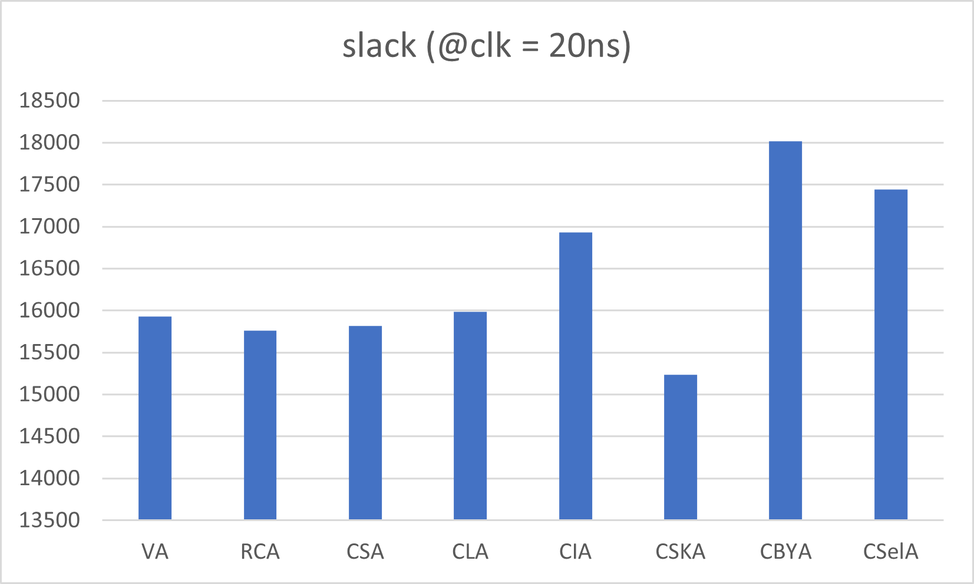
Slack (after synthesis)

Slide 16
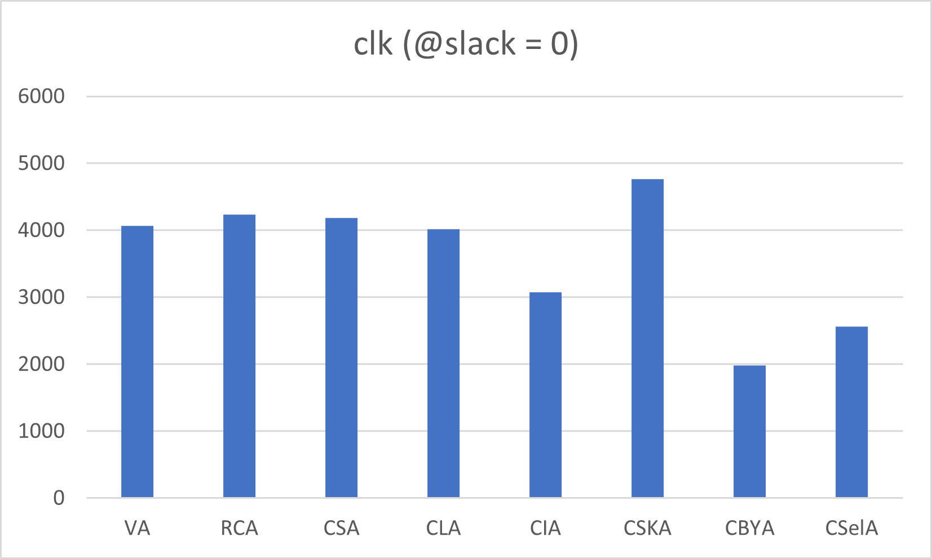
Clock period when slack = 0 (after synthesis)

Slide 17
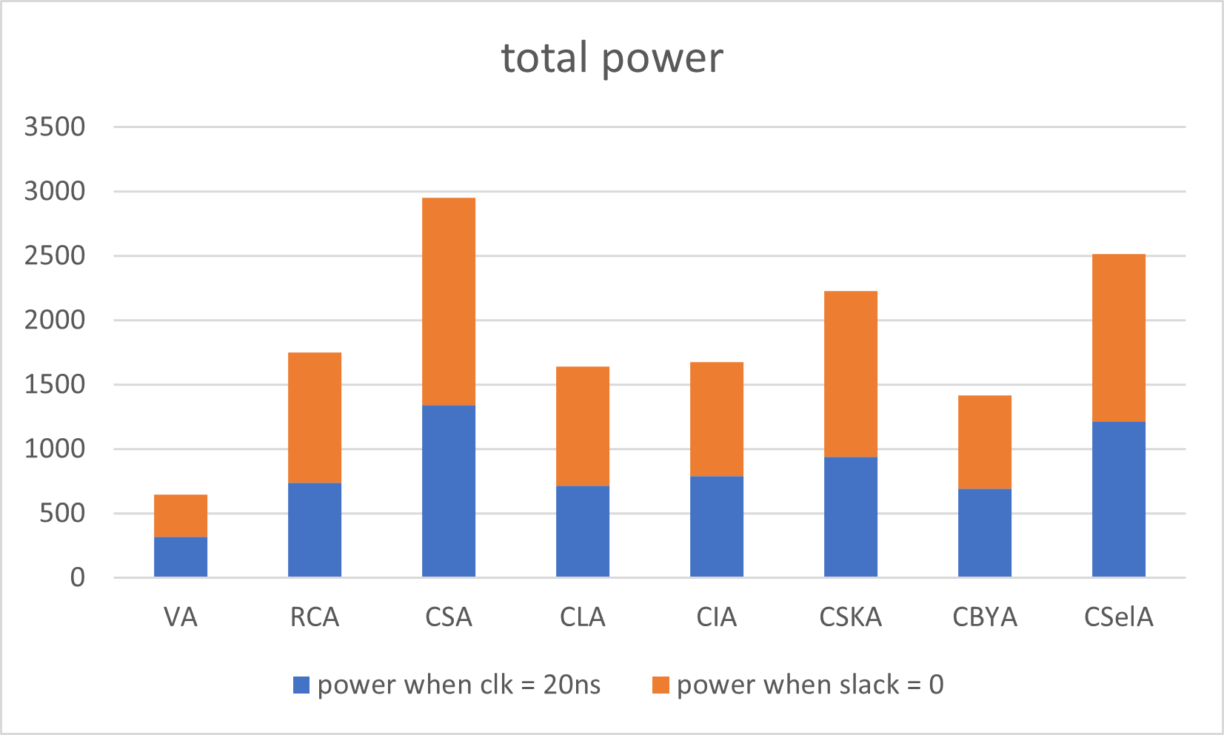
Total power (after synthesis)

Slide 18
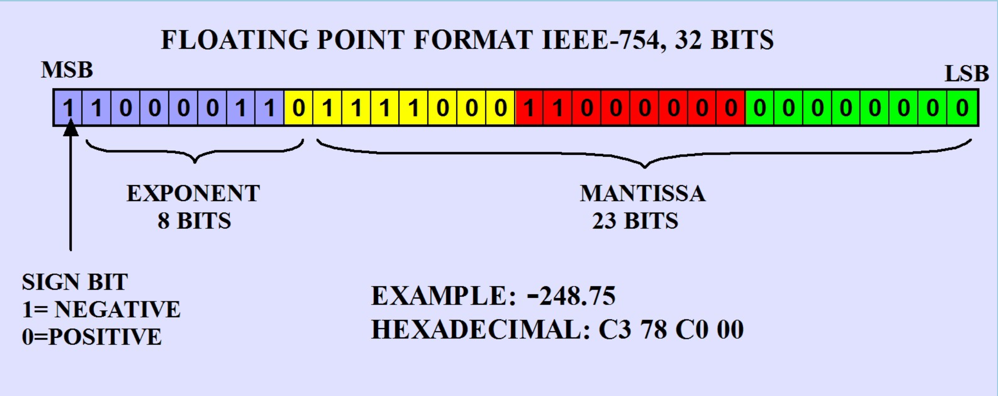
Floating point unit

Slide 19
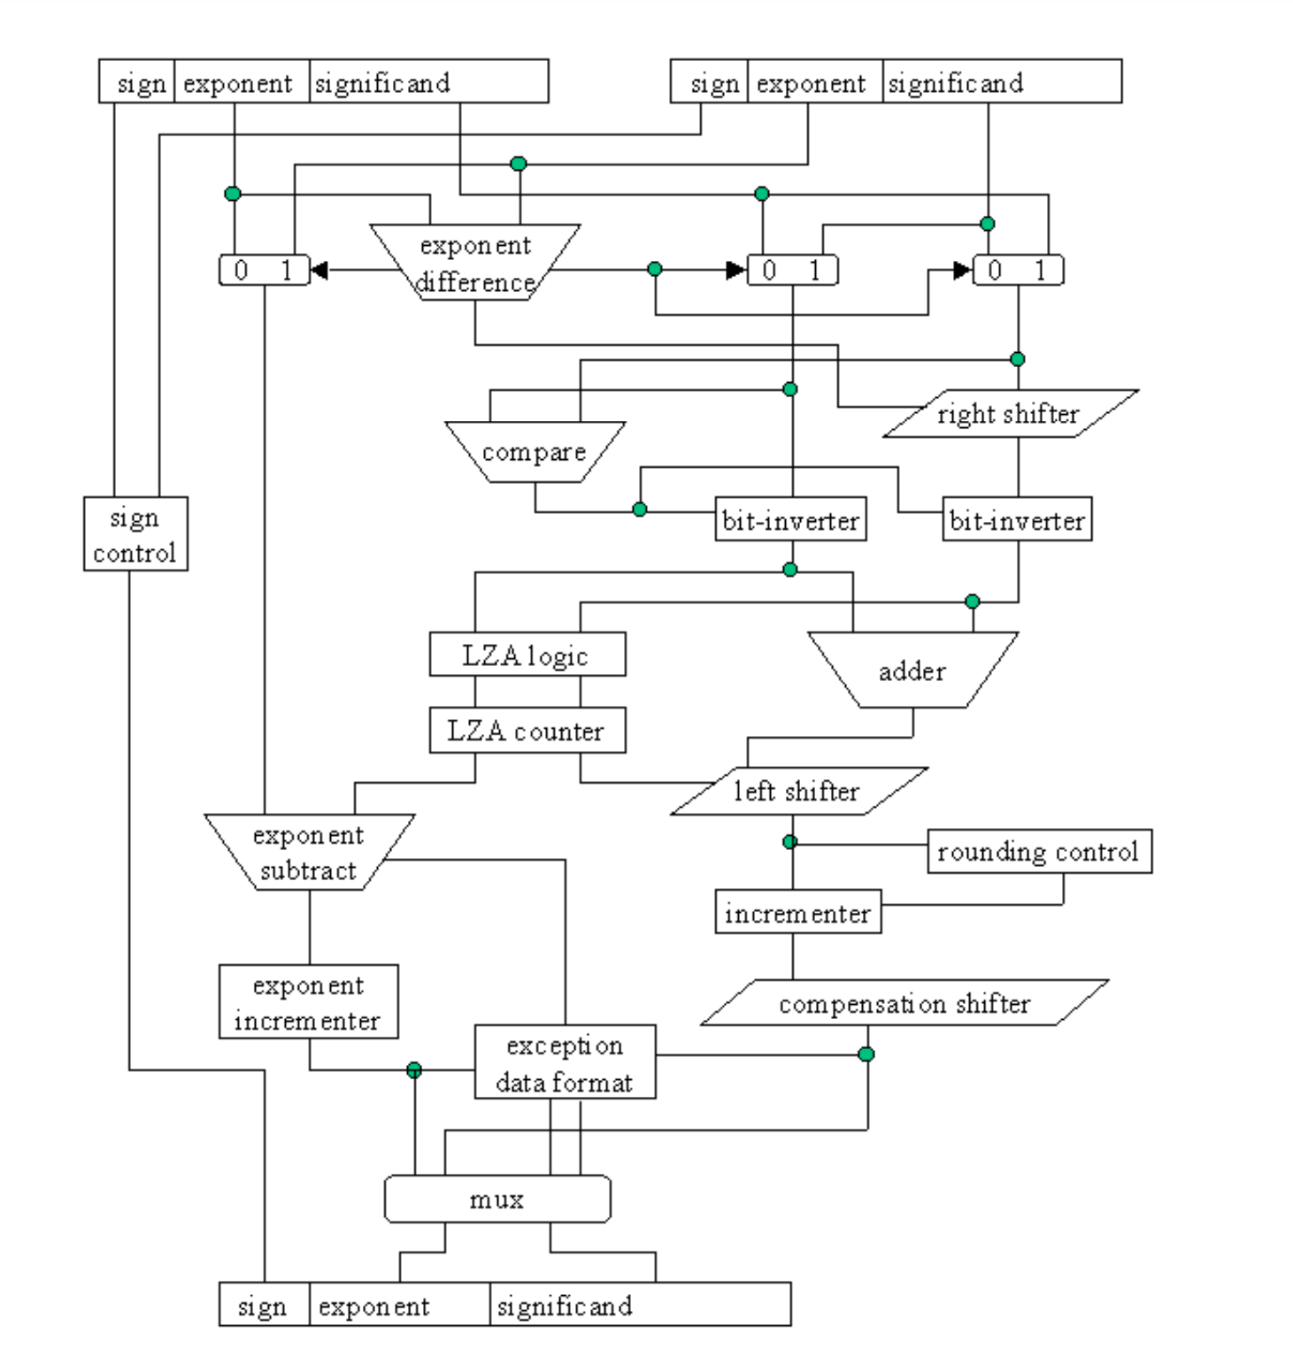

Slide 20
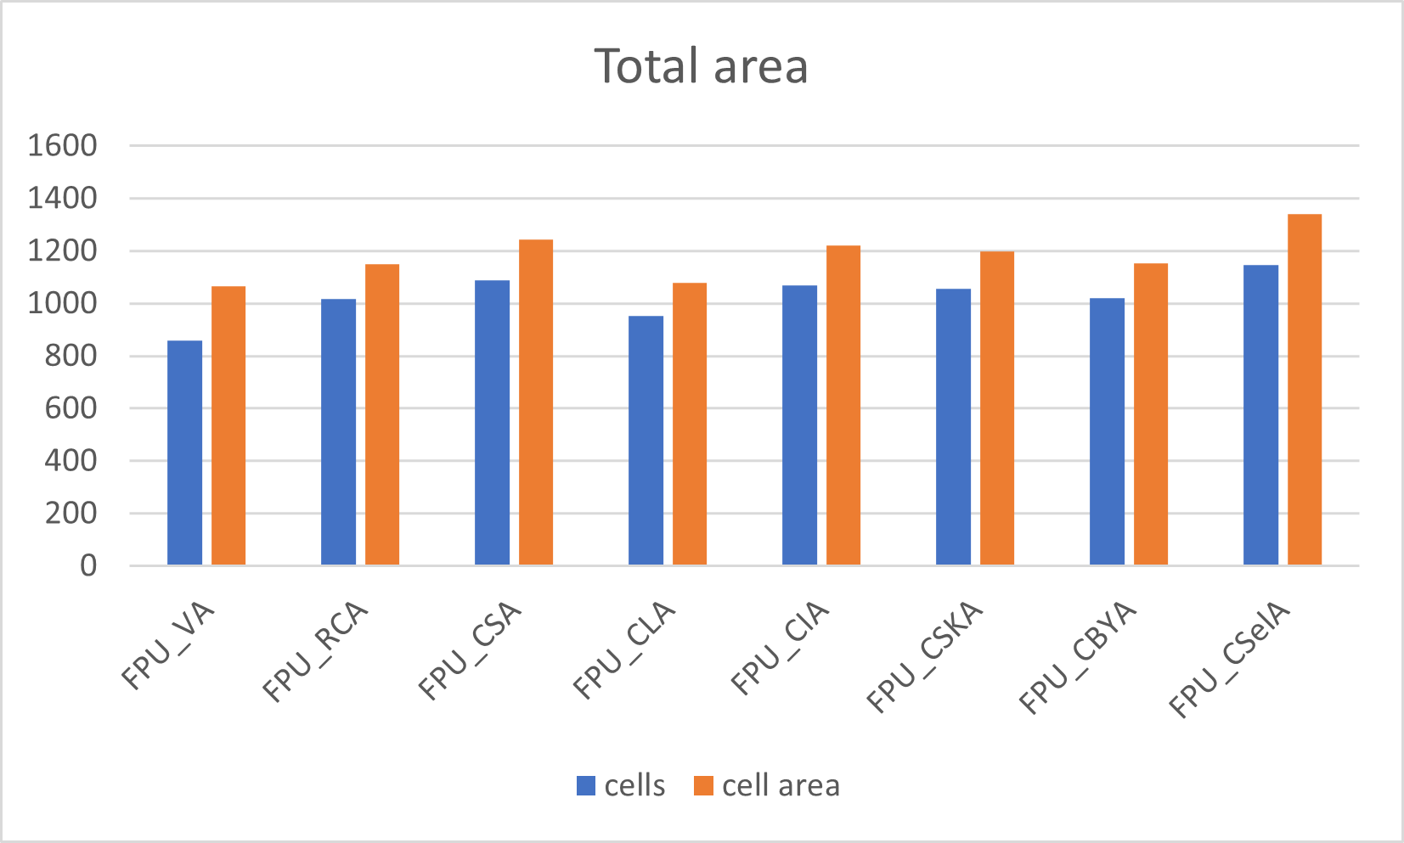
Total area graphs (after synthesis)

Slide 21
Data arrival time (after synthesis)

Slide 22
Slack (after synthesis)

Slide 23
Clock period when slack = 0 (after synthesis)

Slide 24
Total power (after synthesis)

